Slide 1

Capstone Project Phase B
Link Prediction Using DOLORES: Deep Contextualized Knowledge Graph Embeddings to Search for Scientific Papers
Project Supervisors: Dr. Renata Avros and Prof. Zeev Volkovich
Students:Saar Keshet and Evgeny Vexler
Project Number: 23 – 1 – R – 14

Slide 2
Agenda
Introduction
Link Prediction - Cosine similarity
Node Representation Method
Cora Dataset
Results

Slide 3

The Problem
Searching for scientific papers

Slide 4
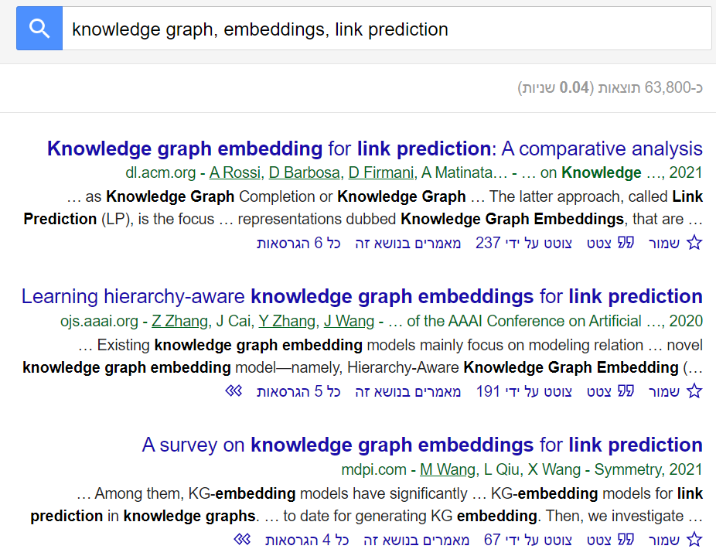
Motivation
Sometimes less relevant results are found when searching for scientific papers.
It can lead to misleading results according to specific papers.
A link prediction approach can assist to an efficient recognition of the appropriate articles.

Slide 5
Suggested Solution
Keyword embedding can be used to construct a knowledge graph.
Two keywords are not necessary related one to another in the knowledge graph.
Using missing link prediction allows to connect entities that have yet been explicitly linked.
By understanding the relationships between entities, it is possible to identify papers relevant to a given query.

Slide 6
Challenges Implementing DOLORES
In phase A of the final project, we discussed a new type of knowledge graph embedding that is called DOLORES which is both deep and contextualized.
Following multiple unsuccessful attempts to implement DOLORES and thorough consultation with the project supervisors, it was concluded that a change in the implementation approach to Node2Vec was necessary.

Slide 7
Flow Chart of the Project
Training:
# Iterations
Remove edges
Start
Load Dataset
Build Graph
Train Model Using Node2Vec
Link Prediction Using The Cosine Similarity
Training over
GUI:
Show results
Search by Name
Load the Dataset into the GUI
Load Results into the GUI
Export Results Into a File
End

Slide 8
Data Processing
Build graph from dataset.
Remove some of the edges in graph.
Train the model.
Perform missing link prediction to predict missing edges.
Repeat for a set number of iterations.
Discard unpredicted edges in graph (edges predicted zero times).

Slide 9
Link Prediction
Link prediction is the task of predicting missing or future links in a network, such as social networks and citation networks.
Missing links are caused when there is a relation between two entities, but one of the entities is missing from the graph, resulting in a broken chain that cannot be used efficiently.
There are number of methods for link prediction:
Jaccard Coefficient
Adamic/Adar
Cosine Similarity
Etc…

Slide 10
Link Prediction - Cosine Similarity
A measure used to determine the similarity between two vectors in a multi-dimensional space.
Cosine similarity calculates the cosine of the angle between them and produces a value between -1 and 1.
cosine_similarity(A, B) = (A · B) / (||A|| * ||B||)
Identical vectors → cosine similarity is 1.
Vertical vectors → cosine similarity is 0.
Opposite direction vectors → cosine similarity is -1.

Slide 11
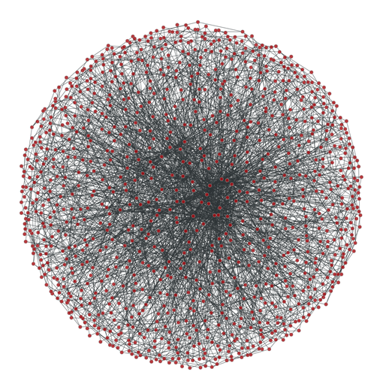
Graph
G=(E,R)
E is a set of entities.
R is a set of edges formed between entities.
E1
R1
E2
R2
R3
E3
E4

Slide 12
Example
Example of a graph, created using the CORA dataset. Nodes represent papers and edges represent connected papers.

Slide 13
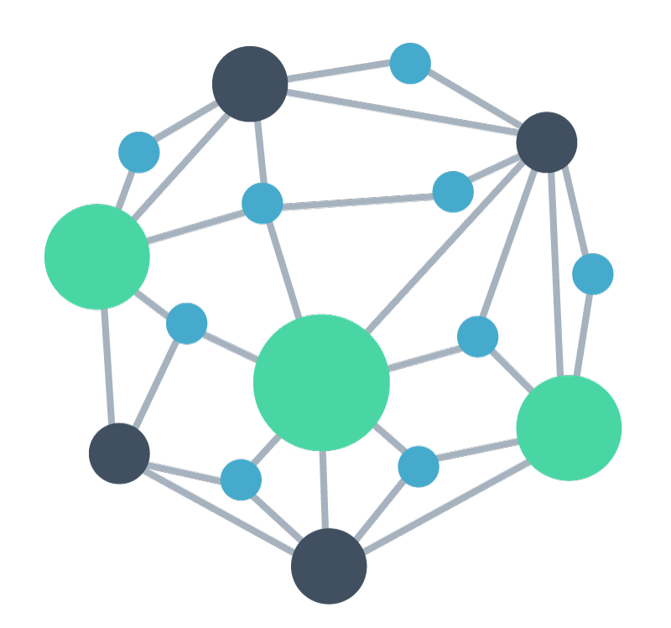
Node2Vec
Node2Vec: Navigating Network Embeddings for Enhanced Analysis

Slide 14
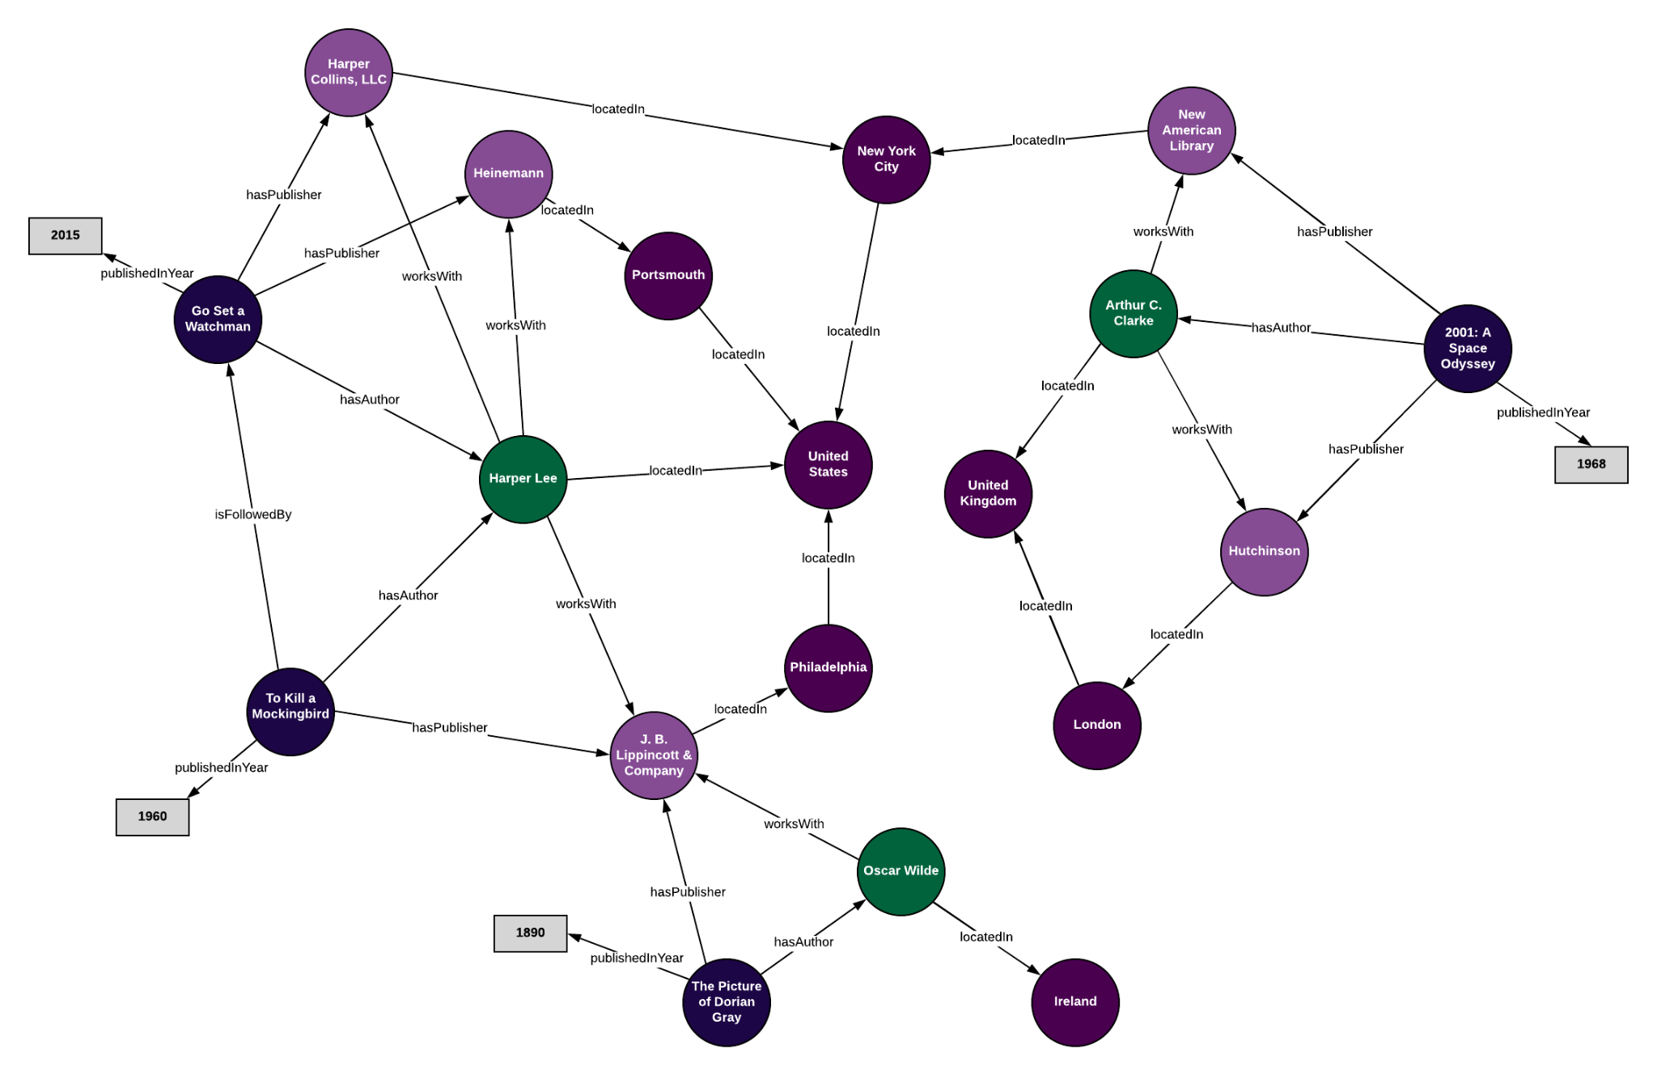
Node2Vec: Graph Embedding through Random Walks and Skip-Gram Learning
Skip-Gram
Random Walks
3. Representation Learning
4. Embedding Visualization

Slide 15
Skip-Gram
Skip-gram is a model used to learn word embeddings in natural language processing.
Using sliding window approach.
Employs a neural network with a hidden layer.
The hidden layer outputs learned dense vector embeddings for words.
The resulting word embeddings are useful for various downstream NLP tasks.

Slide 16
Random Walks
Used to explore the graph and collect information about the structure of the nodes, generating sequences of nodes that capture both local and global relationship
Traversing the graph by moving from one node to another based on a random selection.
Random walks are probabilistic processes that involve taking steps or transitions through a sequence of elements or states.

Slide 17
Representation Learning
Refers to the process of learning low dimensional vector representations.
Node2Vec applies the Skip-Gram model to learn node embeddings.
The model predicts the context (neighboring nodes) given a target node.
Node2Vec learns to generate node embeddings by training the Skip-Gram model on node sequences obtained from random walks.

Slide 18
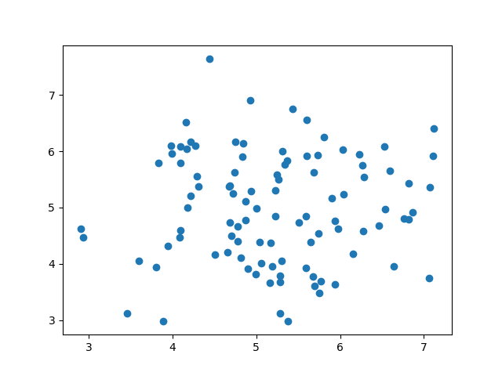
Embedding Visualization
Reduces high-dimensional embeddings to lower-dimensional spaces for visual representation.
Revealing relationships: visualization techniques like scatter plots, and network graph display relationship and patterns within the data.
Provides a means to visually explore and understand learned node embeddings.

Slide 19
CORA
The Cora dataset represents a citation network, where nodes correspond to scientific publications and edges represent citations between the papers. The dataset focuses on a specific research area within computer science, mainly including papers from the following categories:
Machine Learning.
Neural Networks.
Artificial Intelligence.
Database.
Information Retrieval.
2708 papers and 5278 edges between them.
ID | ID
35 | 250
35 | 25
….. | …..

Slide 20
Implementation Using CORA
Load The cora dataset.
Create a graph and remove 30% of the edges.
Train the model using Node2Vec.
Link prediction using Cosine Similarity to predict missing edges.
Reconstruct edges with prediction score of 0.6 and higher.
Count how many times each edge was reconstructed.
Repeat 2-6 for 500 iterations.
Apply the results in the GUI.

Slide 21
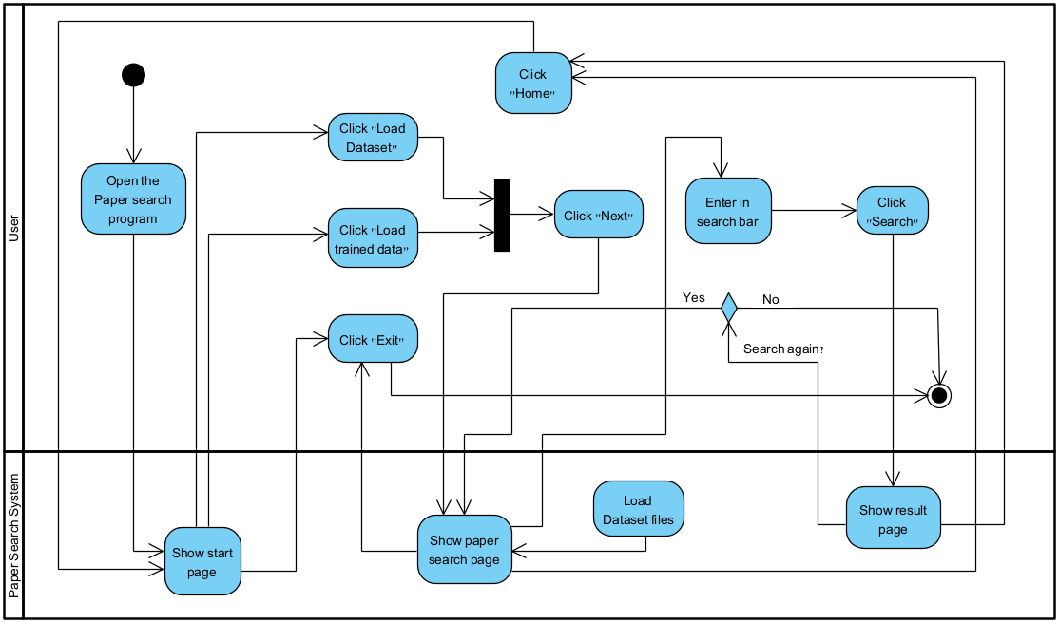
Activity Diagram

Slide 22
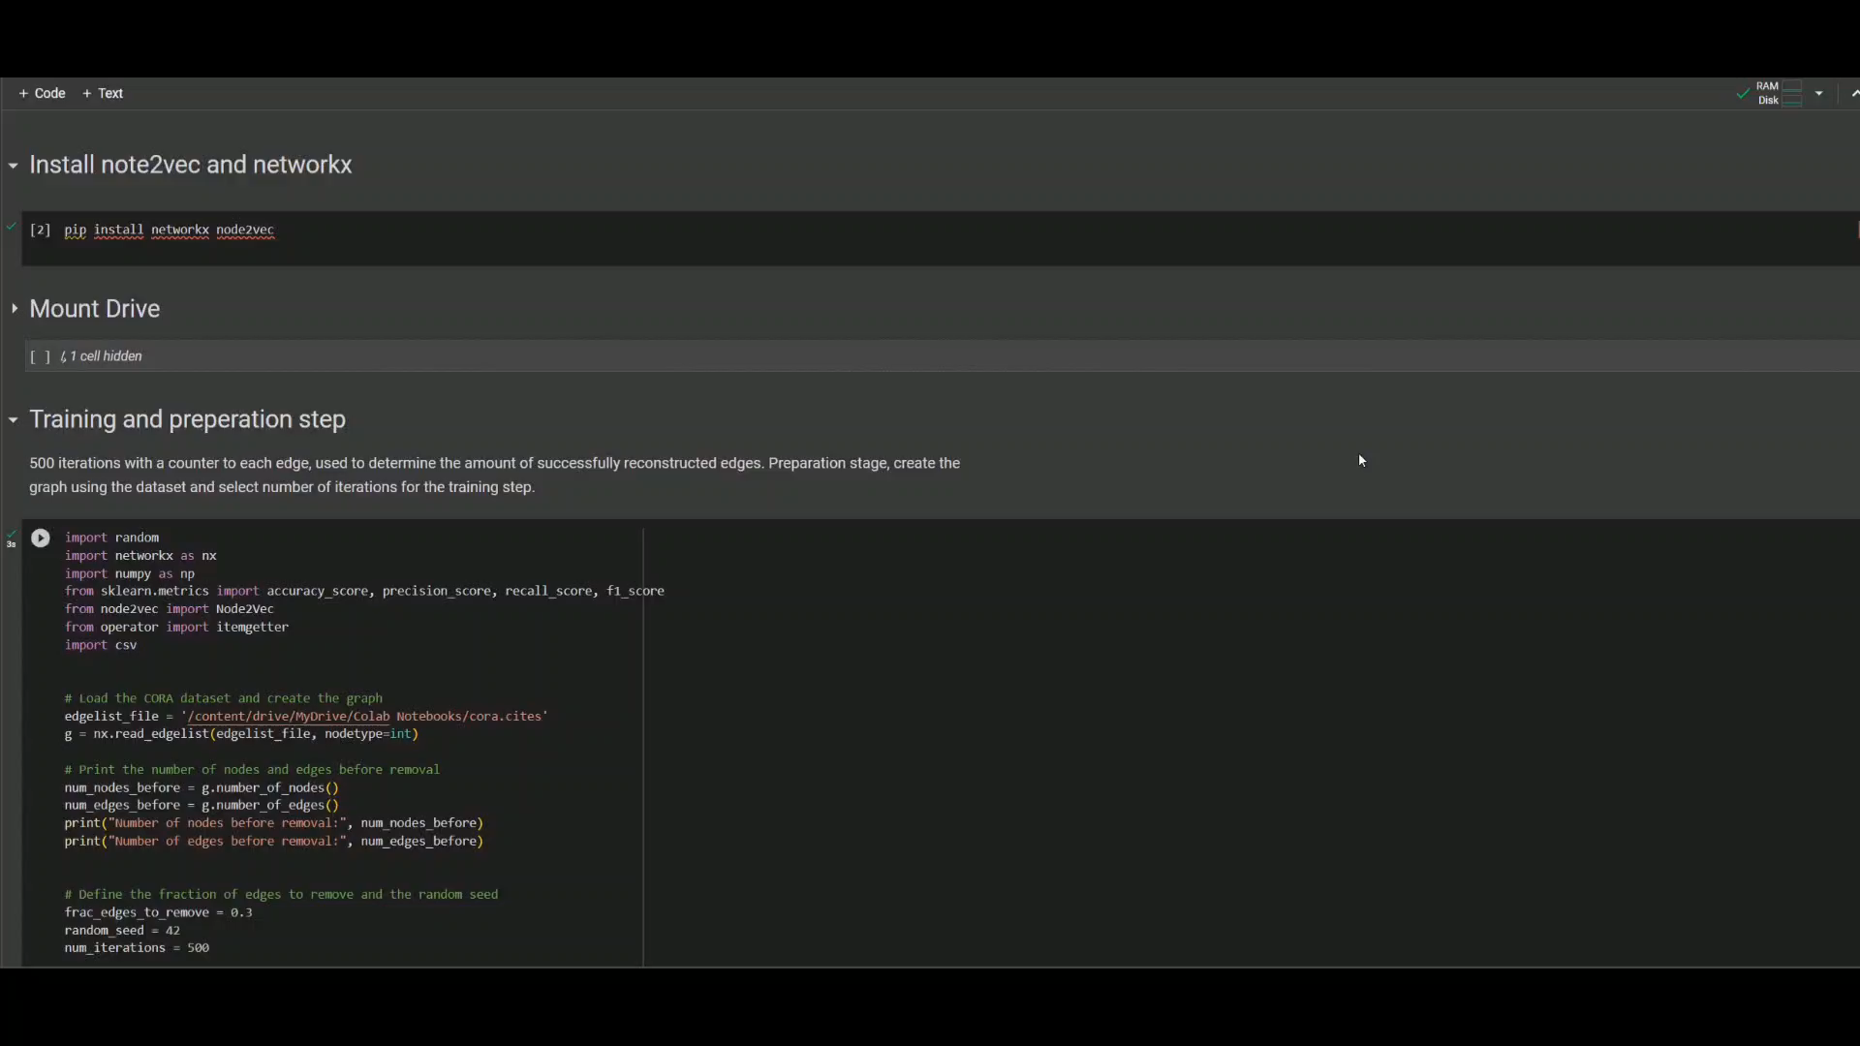
Video

Slide 23
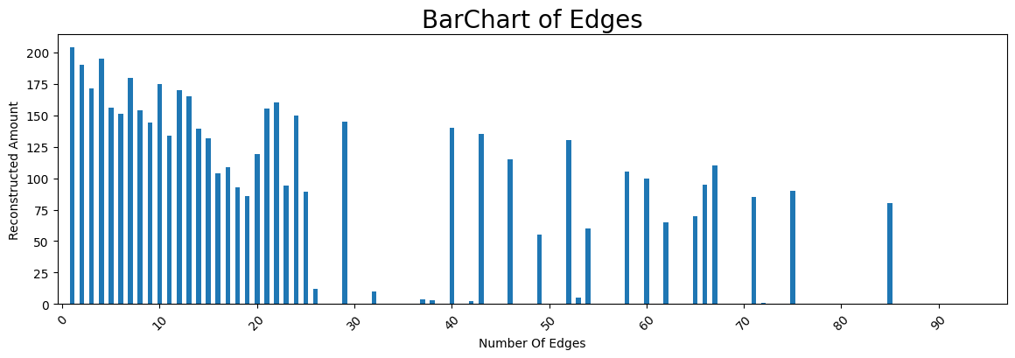
Results

Slide 24
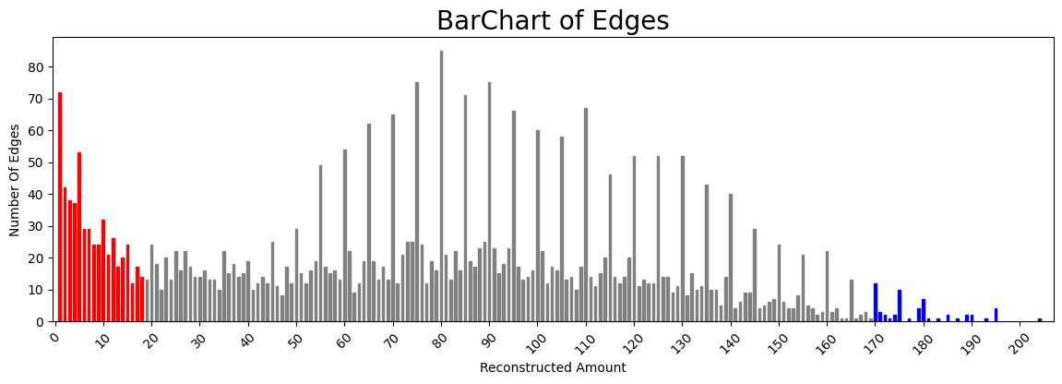
Results

Slide 25
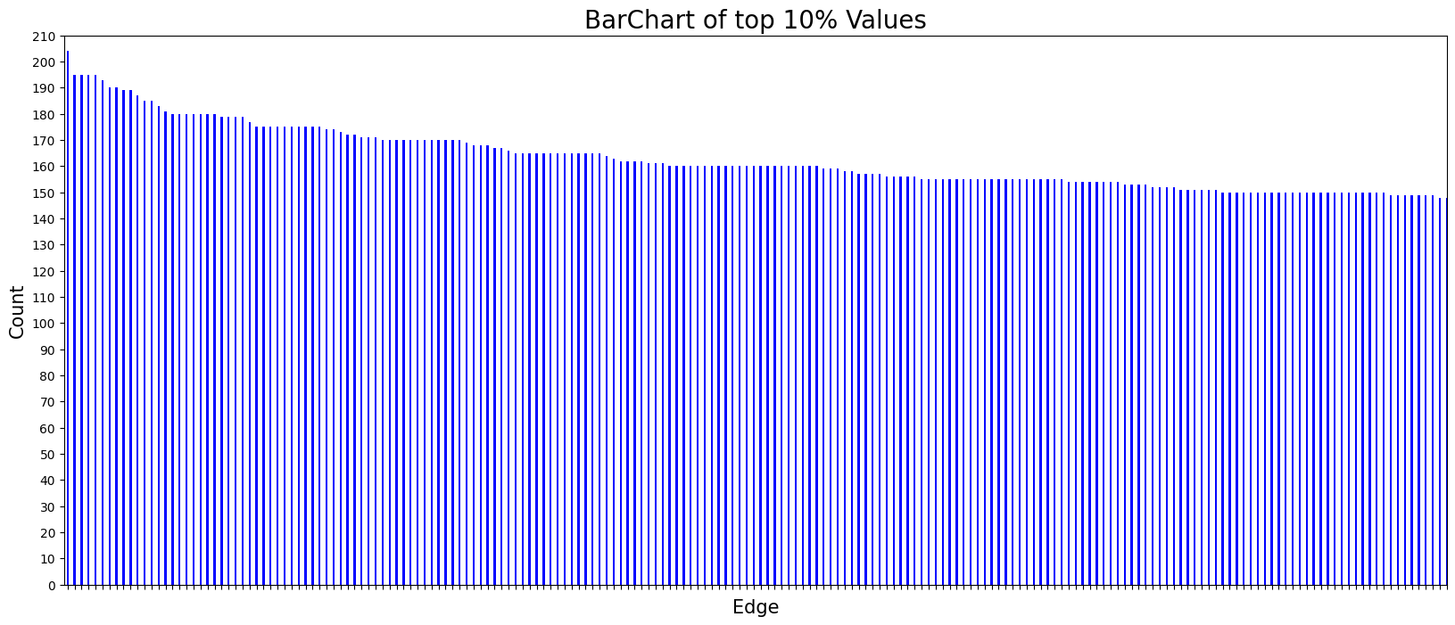
Results

Slide 26
Thanks For Listening!!
Questions??

